Slide 1
FNOL Digitized Data Collection & Processing
Dean Mazzotta/Murali Malipeddu
April 2019

Slide 2
Business Case
Business Case
Claim Handlers struggle to ask the correct questions to accurately determine compensability of Claims at First Notice of Loss (FNOL)
The unstructured approach to handling FNOL increases the time taken from FNOL initiation through approval (timeliness)
Claim leakage exists as FNOL claims are being paid that aren’t warranted (quality)

Slide 3
Intentional Architecture (Draft)
MVP
Claim handlers and CCT users work in ECOS and enter first notice of loss (FNOL) in ECOS UI
Create a framework to generate reflexive questionnaire and make it accessible via REST API
UX framework to display reflexive questionnaire and capture responses.
Store the questions and responses in Database and replicate it to data Warehouse for reporting and DS model training needs.
Pre and post processing rules for DS model invocation
DS Models development & training using the training data from Data Warehouse
3rd Party data to prepopulate data & verification.
Telephony Call recording & speech to text
1
1
2
6
3
3
4
2
Post MVP
5
5
6
4
7
8
7
8

Slide 4
Decision Log - Key Technical Decisions for MVP
Scope | Decision Area | Solution Options Considered | Key Considerations
MVP | UI for FNOL Data Capture | Expand ECOS UI capabilities (external user’s use case to be solved later) Leverage ECOS and implement microservices architecture to provider reflexive question rules and persistence. Build New UI which can be access from ECOS and leveraged by current ECOS users | Will the new UI only support collecting data “not currently collected by ECOS”? Is there the need to pass data from ECOS to the new UI to drive the front-end rules?
MVP | Framework to create and deploy reflexive questions (rules) for data collection | Guidewire accelerator for question sets Leverage DROOLS, similar to Premium Audit implementation | What level of complexity do we anticipate with the question set required of FNOL?
MVP | Data storage location for persisting the questions and answers | Part of claim tree in ECOS. Archive with claim data. Store in AbRe database. New database (may be NO SQL database) | Does the claim data retention applies to these questions and answers? Or can the data be purged independently?
MVP | Transfer data to EDW for reporting/analytics and Data Science model training | Shareplex to replicate data from operational DB to dW. Write ETL jobs to replicate data | Shareplex in place with AbRe & ECOS databases (currently in production), reuse opportunities

Slide 5
Decision Log – Other Key Technical Decisions (After MVP)
Scope | Decision Area | Solution Options Considered | Key Considerations
TBD | Compensability Decision (Rules vs. DS Model) | Create DROOLS rules to make decision on Compensability Create DS model & rules to recommend compensability decision. | TODO
TBD | Mechanism for Fraud detection | Can CFM use this data and detect Fraud? Create model to alert on outliers | TODO
TBD | Potential to implement Chat Bot Interface | Create a Bot and use it in the Chat or Phone conversations | TODO
TBD | Common UX (Insured/Clam Handler) | Combine UI for CCT, Claim Handler and insured. Implement Role Based architecture

Slide 6
Decision Log Prioritization
FNOL Data Capture Arch Significant Items | Priority | POC | Risk (H, M, L) | Complexity (H, M, L) | Timing
MVP
1. UI for FNOL data capture | 2 | Y | H | H
2. Framework to create and deploy reflexive questions (rules) for data collection | 1 | Y | H | H
3. Data storage location for persisting the questions and answers | 3 |  | L | H
4. Transfer data to EDW for reporting/analytics and Data Science model training | 4 |  | L | L
Post MVP
5. Compensability Decision (Rules vs. new ML Model) | 5 |  | M | H
Future State
6. Introduce Fraud Model | 7 |  | M | H
7. Potential to implement Chat Bot Interface | 8 |  | H | H
8. Common UX (Digital/Clam Handler) - Requirement to implement Role Based architecture | 6 |  | M | M

Slide 7
Architecture Activity
04.18.2019 IBM Workshop:
Architecture Focus (Day 3 of workshop)
IBM perspectives on accelerators (not the solution architecture)
Define MVP for FNOL Data Cap
Identify potential impacted systems for the solution (conceptual diagram)
Logistics for the upcoming Arch Workshop - architecture planning, etc.
Week of 04.22.2019
Create and prioritize key architecture decisions
Develop design options aligned to key decisions
Home-work
Reflexive ? Prem Audit Framework
Create draft Intentional Architecture
Provide an update to Peer Review team, collect feedback
Further post workshop - architecture planning, etc.
Week of 04.29.2019
Home-work
GW Reflexive Script UI (SIU)
Refine Intentional Architecture based on Peer Review team feedback
IBM Design Thinking Architecture Session (05.02-05.03)
Drill down UX process, flow, data needs, etc.
Identify POCs
Create architecture user stories (NFRs)
Refine options for key architecture decision
Assess key architecture decision based on risk & complexity
Peer Review Check-ins
Week of 05.06.2019 and beyond
Refine Intentional Arch
Based on priority, create Recommendation Summary Design Doc
Peer Review Check-ins
“Plan” the execution of the design RAPID process

Slide 8
APPENDIX

Slide 9
Non Functional Requirements/Business Clarifications
What is the average daily WC FNOL volume? ~525 per business day & ~20 on holiday (total ~134K claims 2018)
Number of users who can create new WC claims (internal HIG users)? 220 users
Currently National account employers are accessing ECOS UI via internet to FNOL entry. Number of users who can create new WC claims in ECOS exposed to internet users.
273 unique users; Current numbers show that 164 Accounts are active to use Direct Entry into ECOS (internet).
What is the average daily claim count entered by the National accounts users in 2018?
Difference in the number of questions per screen in ECOS UI and FNOL UI
Desired Process Flow via phone intake:
Customer calls HIG (current)
Customer provides basic policy/claimant info (current)
Customer describes accident (Current)
CCT selects Cause of Injury and CDC in ECOS (current)
Contextual questions present to CCT user (new)
CCT user asks Insured questions (new)
Customer answers questions (new)
CCT documents Insured’s answers (new)
CCT completes FNOL (current)
Questions and answers feed into ECOS data fields (new)
System automates request to customer to address questions not answered in Step 6 (new)
Customer answers outstanding questions (new)
Answers feed into ECOS (new)
Handler receives notice of completed questions (new)
** Open item if 11-14 are part of the MVP.
Entered by User | How Reported | National Accounts | All Claims
Insured (External User entering into ECOS) | Direct Entry | 5,788 | 5,860
HIG User | Doctor’s First Report | 73 | 1,289
HIG User | Email | 51 | 69
HIG User | Fax | 7,770 | 38,520
HIG User (Webworks) | Internet | 1,360 | 16,395
HIG User | Medical Bill | 155 | 3,983
HIG User (MVP Target) | Phone | 4,005 | 67,459
HIG User | Unknown | 1 | 4
HIG User | Mail |  | 1
HIG User | Word re-keyed |  | 1
 | Grand Total | 19,203 | 133,581

Slide 10
Non Functional Requirements/Business Clarifications
Decision Area | Key Considerations | Answers
UI for FNOL Data Capture | Will the new UI only support collecting data “not currently collected by ECOS”? | We will be reviewing the existing FNOL flow as part of this initiative. Currently some Compensability questions are being asked at FNOL already but in a very disjointed and non-customer friendly way. We would like the existing data and our new questions to flow appropriately. I do not see our tool as a separate “glue-on” UI. This should be incorporated into our FNOL flow or at least flow seamlessly.
 | Is there a need to pass data from ECOS to the new UI to drive the front-end rules? | Yes. Our ruleset will be defined based on data collected at FNOL. (Cause of Injury/CDC)
 | Does the questionnaire need to be derived based on the previous claim history of that account/policy or any other ECOS data? Or is it not dependent on ECOS data? | Not based on our current thinking
 | What is the difference between the questionnaires in FNOL UI for CCT/Claim handler vs Insured? If lean questionnaire is preferred for Insured then can that be configured with simple rules? | CCT/Handler are seeing the UI and asking the questions to the Insured on the phone. This is 1 ruleset. At this point our question set seems fairly simple and feel it can be done with a ruleset.
 | What percent of claims entered by Insured? [Murali] Is the 50% FNOL count coming from Insured in to ECOS? Means are they opening ECOS and entering in ECOS UI? I thought very less count for ECOS internet users. Do you know the number of internet users? And daily FNOL intake volume from these internet users? | 50% Claims can be created 2 ways. 1 – Direct entry by external users (5% of intake) 2 – Created by a HIG CCT user. (95%) This population is reported via multiple channels (Phone calls, online reporting via works form, e-,mail, etc)
 | Currently National account employers are accessing ECOS UI via internet to FNOL entry. Will this access be removed when FNOL portal goes live? Any differentiation in questionnaire based on internet or intranet access? | Yes – will be sunset No – question set should be the same (for the users working in ECOS). FNOL must be different.
 | Difference in data quality on the claims entered by CCT vs Employers? [Murali] In the current world, Any difference in the data quality when the Insured logs in to ECOS UI and enters a claim vs CCT talks over the phone and enters the claim in ECOS? | Not if we build the Digital FNOL correctly Good question. We will do an assessment into this. I suspect not given the data field requirements are the same and the customers who use this vehicle report high volumes.
Framework to create and deploy reflexive questions (rules) for data collection | What level of complexity do we anticipate with the question set required of FNOL? | At this point looks like each question set will be no more than 10 questions with a couple possible branches but T&L will confirm this
Data storage location for persisting the questions and answers | Does the claim data retention applies to these questions and answers? Or can the data be purged independently? [Murali] Are you expecting to use this data for any litigations? Or compliance needs? | Retain Both – if we’re using this data to drive system compensability decisions the questions/answers will need to be retained for compliance/legal reasons.
Transfer data to EDW for reporting/analytics and Data Science model training | [Murali] Other than compensability, Fraud modelling are you expecting this data to be used anywhere else? Means do we need to share with any downstream systems? | Yes, need to report out and use data for DS modeling Not based on our current thinking

Slide 11
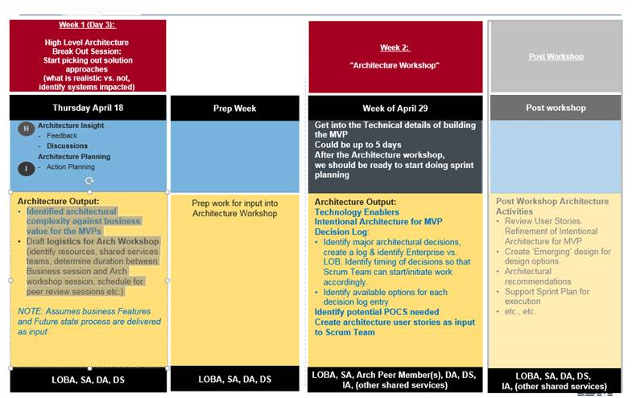
Design Thinking Workshop - Architecture

